Slide 1
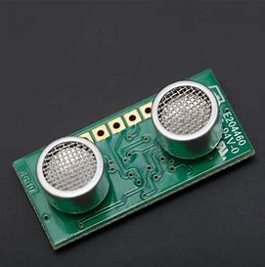
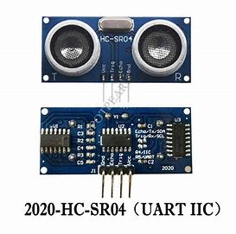
Ultrasonic Sensor
Zhirui Sun

Slide 2
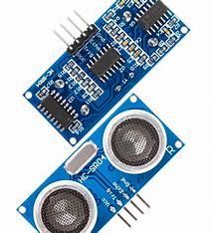
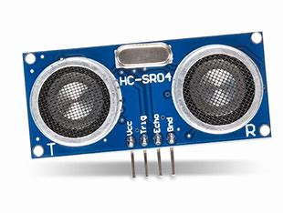
What is an ultrasonic sensor？
An ultrasonic sensor is an electronic device that emits ultrasonic waves and converts the reflected sound into electrical signals to determine the distance of the object. Ultrasonic waves travel faster than audible sound.

Slide 3
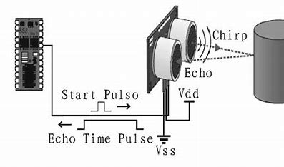
Principle of ultrasonic sensor
The basic physical principle of the ultrasonic sensor is that the sensor sends ultrasonic pulses and receives them back. The distance to the object can be determined by using the time difference between the transmitted signal and the received signal.

Slide 4
Important characteristics of ultrasonic sensors
resolving power
Linearity
Sensitivity
Directivity（measuring range）
working temperature （Stability）

Slide 5
Sensor parameter table：
Specifications | Measurement
Working Voltage | DC 5V
Working Current | 15mA
Working Frequency | 40Hz
Max Range | 4m
Min Range | 2cm
Measuring Angle | 15 degree
Trigger Input Signal | 10µS TTL pulse
Echo Output Signal | Input TTL lever signal and the range in proportion
Dimension | 45 * 20 * 15mm

Slide 6

Static characteristic test

Slide 7
Linearity
Method： use the plane book as a test object. The ultrasonic sensor is placed at a distance of 0 cm
from the ruler, and the book is gradually away from the ultrasonic sensor. Start from 0 cm
and move to 30 cm.
Equipment： A ruler(0-30cm)
A book(or any flat item that can reflect sound waves),
Arduino UNF
HC-SR04 Ultrasonic Distance Sensor

Slide 8
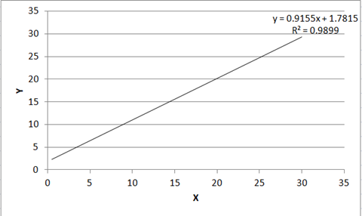
Obtaining data （Linearity）
X=Move the object | Y=Serial output [Distance(cm)] | Error(%)
0.0 | 2352 | Infinity
0.5 | 4.15 | 730
1.0 | 3.43 | 243
1.5 | 3.07 | 104.7
2.0 | 4.01 | 100.5
4.0 | 4.10 | 2.5
6.0 | 6.05 | 0.83
8.0 | 8.66 | 8.25
12.0 | 12.04 | 0.33
18.0 | 18.14 | 0.78
24.0 | 24.15 | 0.625
30.0 | 29.76 | 0.8
Chart

Slide 9
Sensitivity
Method： use the plane book as a test object. The ultrasonic sensor is placed at a distance of 0 cm
from the ruler, and the book is gradually away from the ultrasonic sensor. Start from 0 cm
and move to 30 cm. Then subtract the input value X from the output value Y to get the
difference, and divide the difference by the input value X to get the value of Error on the
right side of the table
Equipment： A ruler(0-30cm)
A book(or any flat item that can reflect sound waves),
Arduino UNF
HC-SR04 Ultrasonic Distance Sensor

Slide 10
Obtaining data （Sensitivity）
X=Move the object | Y=Serial output [Distance(cm)] | Error(%)
0.0 | 2352 | Infinity
0.5 | 4.15 | 730
1.0 | 3.43 | 243
1.5 | 3.07 | 104.7
2.0 | 4.01 | 100.5
4.0 | 4.10 | 2.5
6.0 | 6.05 | 0.83
8.0 | 8.66 | 8.25
12.0 | 12.04 | 0.33
18.0 | 18.14 | 0.78
24.0 | 24.15 | 0.625
30.0 | 29.76 | 0.8
From the value of Error, we can conclude that the sensitivity of the sensor is very high within a reasonable distance.

Slide 11
Directivity（measuring range）
Method use the plane book as a test object. The ultrasonic sensor is placed at a distance of 0 cm
from the ruler, and the book is gradually away from the ultrasonic sensor. Start from 0 cm
and move to 30 cm.
Equipment： A ruler(0-30cm)
A book(or any flat item that can reflect sound waves),
Arduino UNF
HC-SR04 Ultrasonic Distance Sensor
Therefore, we get that the sensor range is about 4-220 cm.

Slide 12
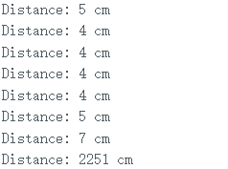
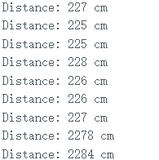
Obtaining data （Directivity）
X=Move the object | Y=Serial output [Distance(cm)]
0.0 | 2352
1.0 | 2450
2.0 | 2261
4.0 | 4.10
5.0 | 5.08
10.0 | 10.06
50.0 | 50.09
150.0 | 152.71
200.0 | 219.58
220.0 | 223.47
240.0 | 2479

Slide 13
working temperature （Stability）
Method: We need to keep the normal temperature and fix the sensor for long-term observation.
Temperature：Normal temperature state
Equipment： A ruler(0-30cm)
A book(or any flat item that can reflect sound waves),
Arduino UNF
HC-SR04 Ultrasonic Distance Sensor

Slide 14
come to conclusion
At normal temperature, it can work for a long time without failure

Slide 15
Summary
In a word, we have tested the characteristics of the sensor and obtained the data we need. We can compare it with the previous parameter table. There is a large error in the maximum range, which may be due to my inadequate control of the quantity during the experiment. However, there is a small error in the minimum range.

Slide 16
end

